Slide 1

A robust approach for effective spam detection using supervised learning techniques Presented By: B. SATHWIKA 20R01A05K0 K. SRINIVAS 20R01A05L8 K. ABHISAIK REDDY 20R01A05M1

Slide 2
ABSTRACT
Spam detection remains a crucial challenge in the digital age, as the proliferation of unwanted and malicious content continues to undermine user experiences and security. This paper proposes a robust approach for enhancing the accuracy and efficiency of spam detection using supervised learning techniques.
The proposed approach leverages the power of supervised learning, a class of machine learning algorithms that learns from labeled training data, to build a highly accurate spam detection model. By training on a diverse and representative dataset containing both legitimate and spam content, the model learns intricate patterns, features, and characteristics that distinguish between the two categories. This allows the model to generalize well to unseen data and accurately classify incoming messages.
Key to the effectiveness of the approach is the selection and engineering of relevant features from the message content, including textual, structural, and metadata-based features. Additionally, the study explores the applicability of various supervised learning algorithms, such as decision trees, support vector machines, and neural networks, comparing their performance in terms of accuracy, precision, recall, and F1-score.

Slide 3
INTRODUCTION
In the contemporary digital age, spam remains an enduring challenge that disrupts efficient communication, compromises security, and degrades user experience. To combat this issue effectively, a robust approach utilizing supervised learning techniques has emerged. Supervised learning, a subset of machine learning, harnesses labeled data to distinguish between legitimate and spam content. This paper introduces a comprehensive framework that leverages supervised learning for accurate and adaptable spam detection. Through feature engineering, algorithm selection, and handling real-world challenges, this approach aims to enhance the efficacy of spam detection systems, contributing to a safer and more enjoyable digital environment.

Slide 4
PROBLEM DEFINITION
The proliferation of spam, characterized by unwanted and often malicious content, poses a persistent challenge in modern digital communication. Unwanted messages inundate email inboxes, social media platforms, and various communication channels, disrupting user experience, impeding legitimate communication, and potentially compromising digital security. Traditional rule-based methods and simplistic filtering mechanisms are proving insufficient in effectively identifying and mitigating the evolving tactics of spammers. Therefore, there is a pressing need for a robust spam detection approach that can accurately differentiate between legitimate and spam content while adapting to the dynamic nature of spamming techniques. This paper seeks to address this problem by proposing an approach that leverages supervised learning techniques to enhance the accuracy, adaptability, and overall efficacy of spam detection systems.

Slide 5
EXISTING SYSTEM
Existing spam detection systems encompass diverse methods such as rule-based filters, keyword filtering, Bayesian filters, content-based filters, machine learning-based approaches (such as decision trees and neural networks), ensemble methods, heuristic filters, sender reputation systems, deep learning, and cloud-based services. However, these methods often face challenges with evolving spam tactics, resulting in false positives and negatives. A robust approach using supervised learning aims to address these limitations by leveraging labeled data to enhance accuracy and adaptability in spam detection.

Slide 6
DISADVANTAGES OF EXISTING SYSTEM
Existing spam detection systems suffer from limitations, including inflexibility to adapt to new tactics, high rates of false positives and negatives, computational complexity, challenges with imbalanced data, susceptibility to spammers' adaptations, and impacts on user experience. Maintenance overhead, overfitting, and limited context awareness further hinder their effectiveness. A robust approach utilizing supervised learning aims to mitigate these drawbacks by leveraging labeled data for enhanced accuracy and adaptability in spam detection..

Slide 7
PROPOSED SYSTEM
The proposed system aims to enhance spam detection using supervised learning. By leveraging labeled data, it improves accuracy and adaptability, addressing the limitations of existing methods. This approach considers diverse features, selects suitable algorithms, and handles imbalanced data. Ultimately, it aims to provide a more efficient and effective solution to the persistent problem of spam in digital communication.

Slide 8
Advantages OF PROPOSED SYSTEM
The proposed system offers several benefits:
Enhanced Accuracy: Leveraging supervised learning ensures precise spam detection through pattern recognition.
Adaptability: The system evolves with evolving spam tactics, reducing false negatives and staying current.
Feature Diversity: Examining various message aspects aids in accurately distinguishing spam from legitimate content.
Imbalanced Data Handling: Skillful management of imbalanced datasets boosts detection performance.
Reduced Maintenance: The adaptable design minimizes the need for frequent updates.
These advantages collectively establish the proposed system as a promising solution for enhancing spam detection accuracy and efficacy in today's digital landscape.

Slide 9
SYSTEM REQUIREMENTS
H/W System Configuration:
Processor - Pentium –IV
RAM - 4 GB (min)
Hard Disk - 20 GB
Key Board - Standard Windows Keyboard
Mouse - Two or Three Button Mouse
Monitor - SVGA

Slide 10
SOFTWARE REQUIREMENTS:
Operating system : Windows 7 Ultimate.
Coding Language : Python.
Front-End : Python.
Back-End : Django-ORM
Designing : Html, css, javascript.
Data Base : MySQL (WAMP Server).

Slide 11
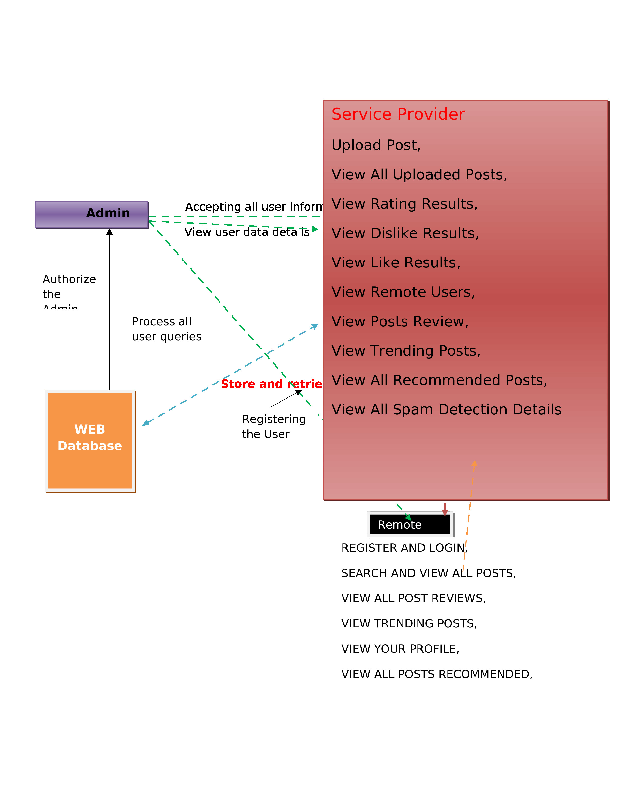
SYSTEM DESGIN

Slide 12
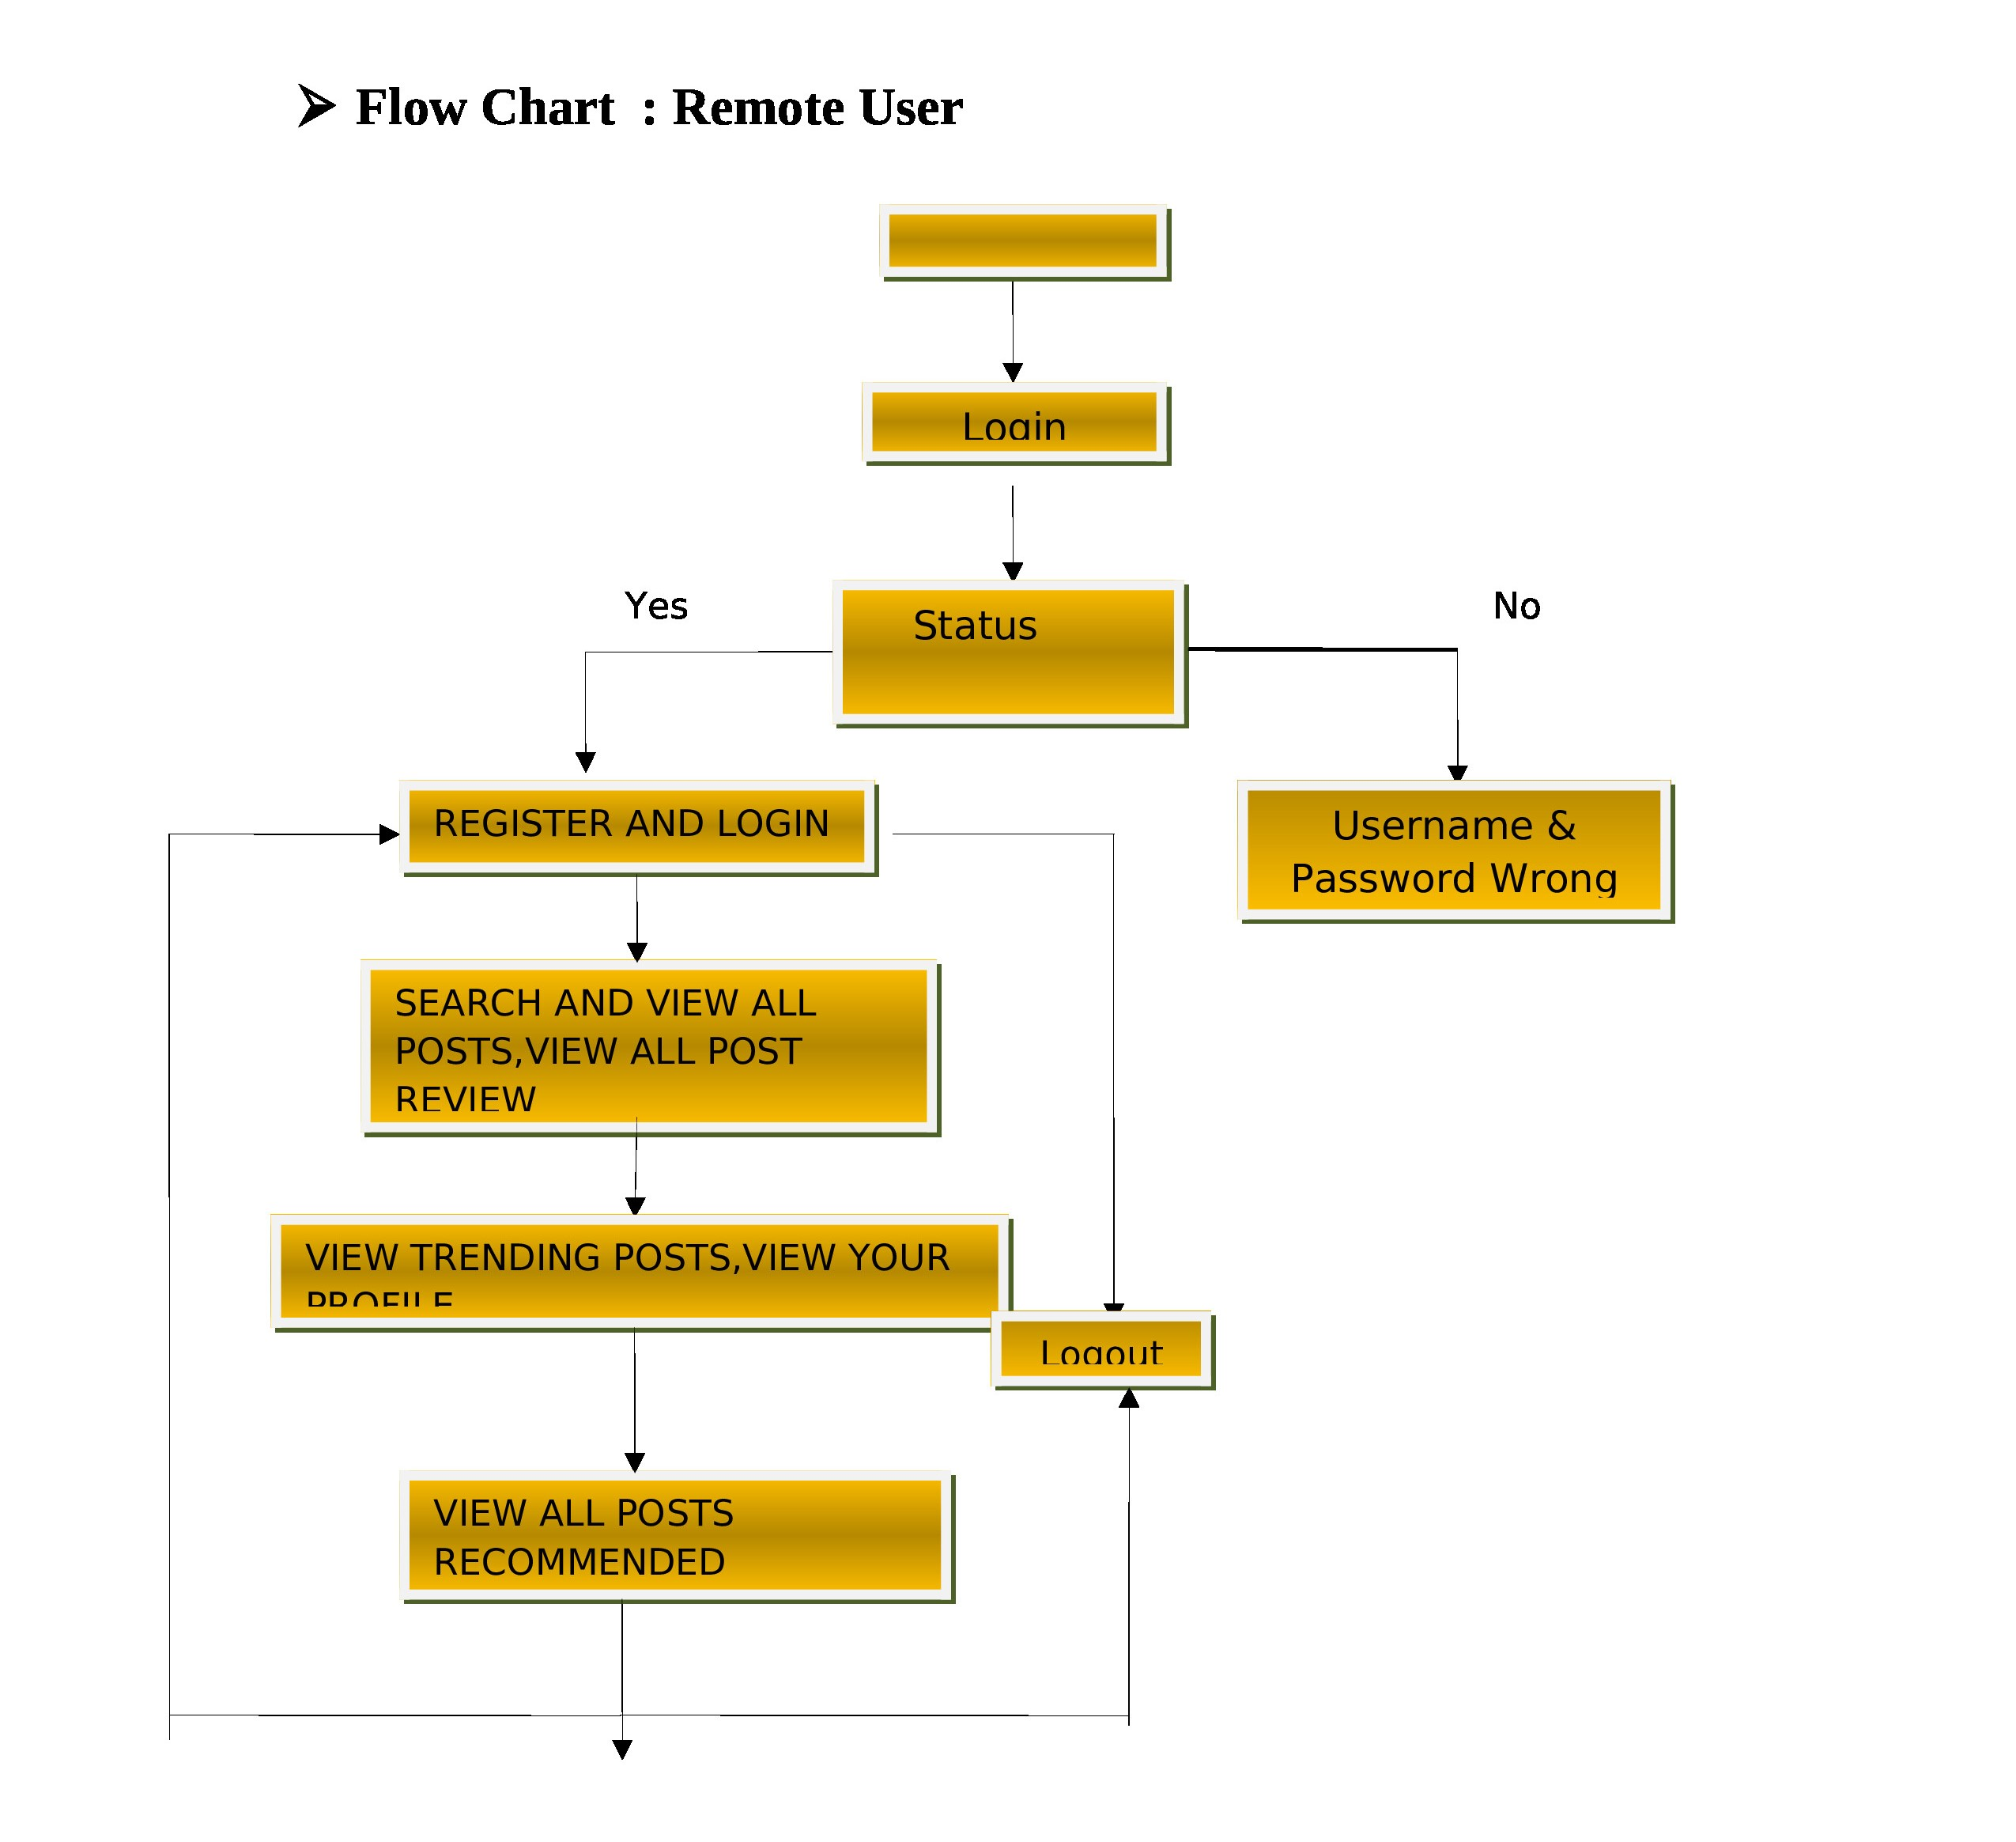
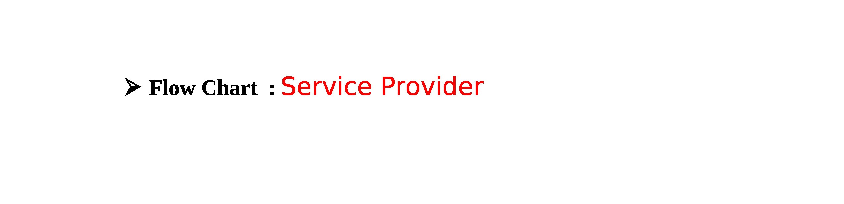
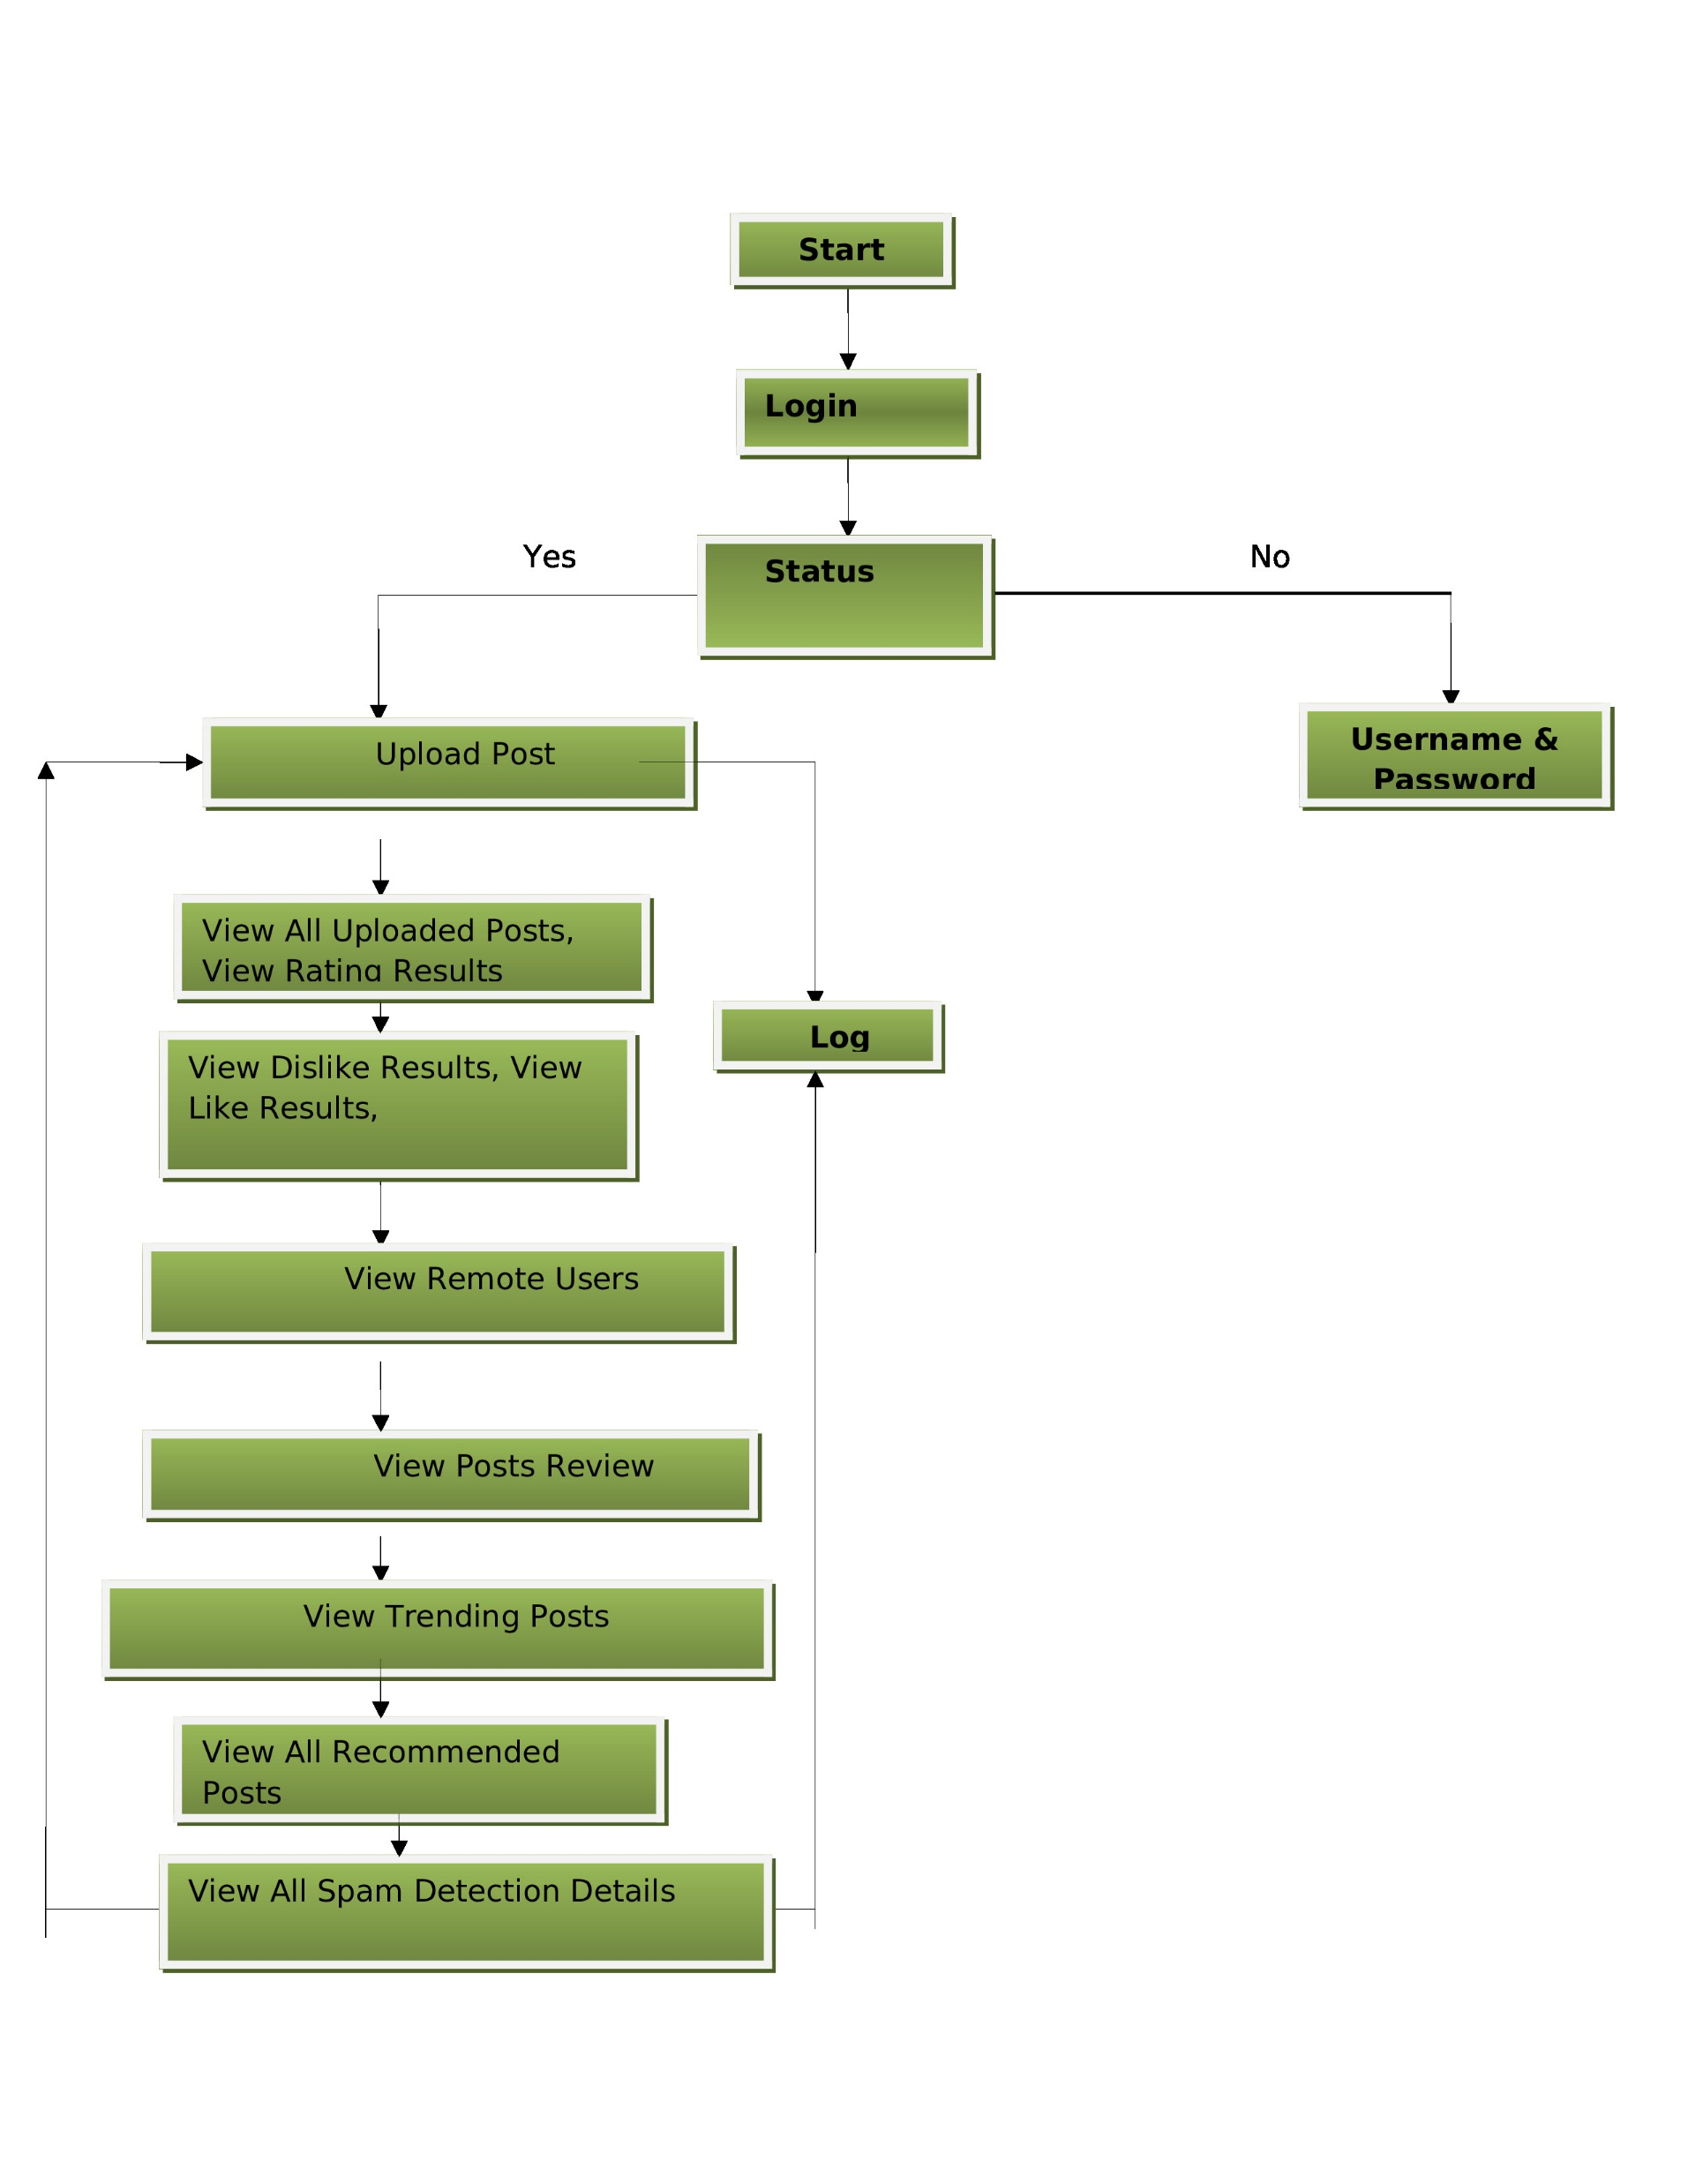
FLOW CHART DIAGRAMs

Slide 13
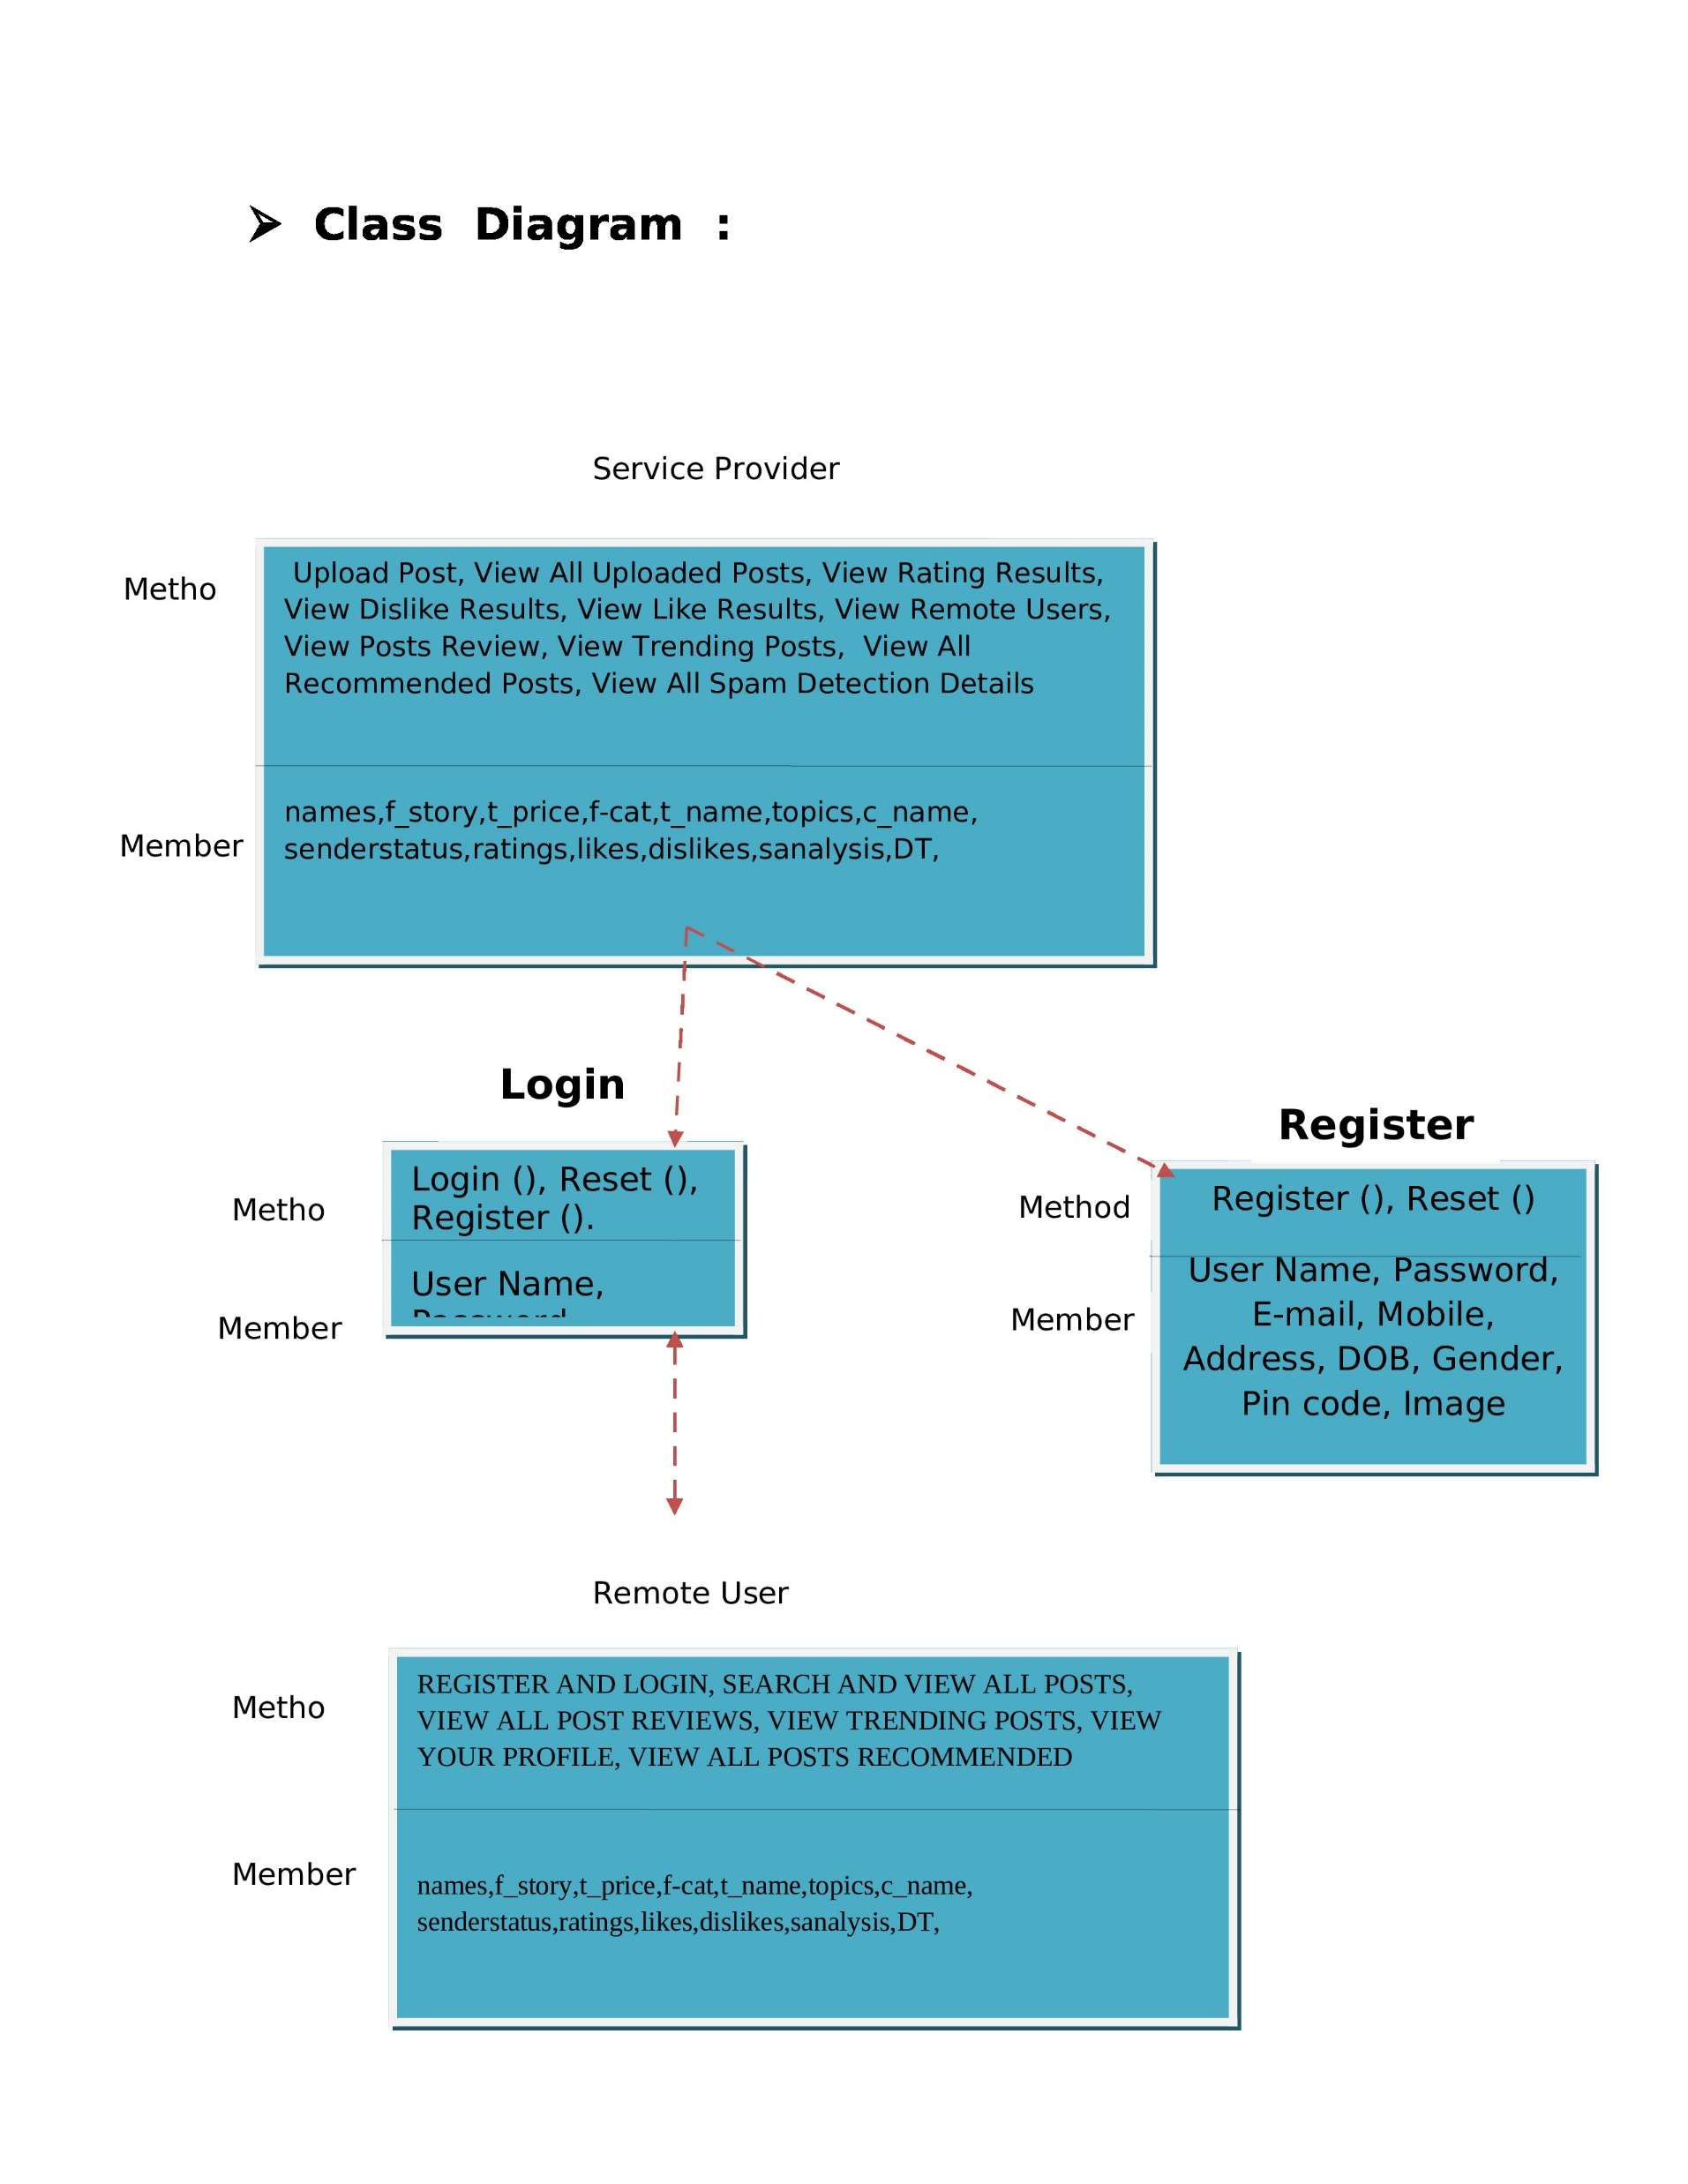
CLASS DIAGRAM

Slide 14
IMPLEMENTATION
Service Provider
In this module, the Service Provider has to login by using valid user name and password. After login successful he can do some operations such as
Login, Browse and Train & Test Data Sets, View Trained and Tested Accuracy in Bar Chart, View Trained and Tested Accuracy Results, View Detection Product Review Type, Find Detection Product Review Type Ratio, Download Detection Product Review Data Sets, View Detection Product Review Type Ratio Results, View All Remote Users.
View and Authorize Users
In this module, the admin can view the list of users who all registered. In this, the admin can view the user’s details such as, user name, email, address and admin authorizes the users.
Remote User
In this module, there are n numbers of users are present. User should register before doing any operations. Once user registers, their details will be stored to the database. After registration successful, he has to login by using authorized user name and password. Once Login is successful user will do some operations like REGISTER AND LOGIN, DETECT PRODUCT REVIEW TYPE, VIEW YOUR PROFILE.

Slide 15
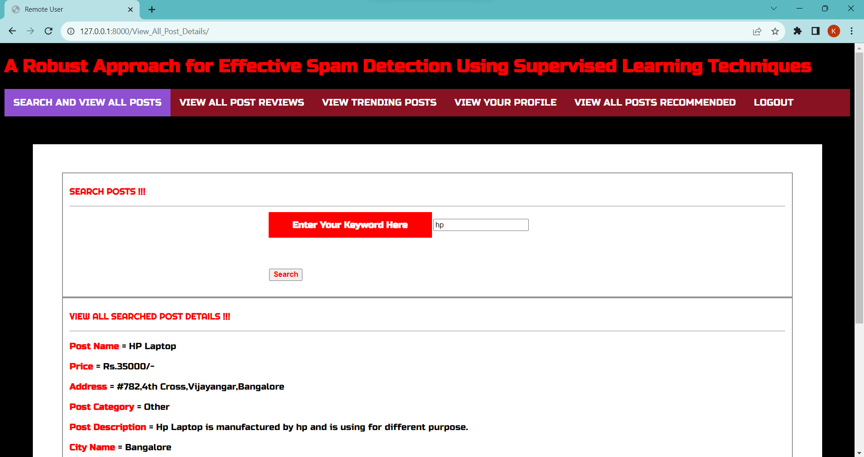
OUTPUT SCREENSHOT

Slide 16
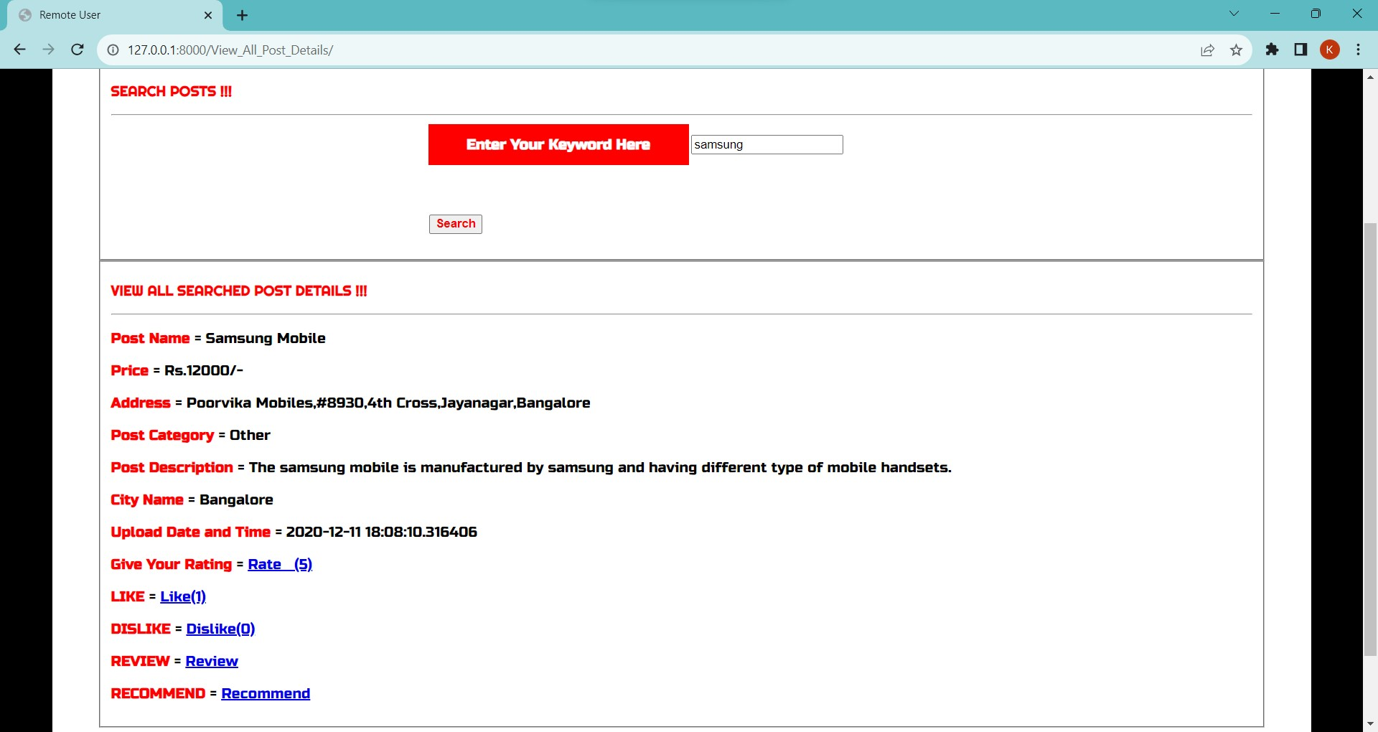
OUTPUT SCREENSHOT

Slide 17
CONCLUSION AND FUTURE ENHANCEMENTS
In conclusion, the proposed robust spam detection approach using supervised learning techniques offers improved accuracy, adaptability, and efficiency compared to existing methods. Its capacity to consider diverse features, handle imbalanced data, and minimize false positives marks a significant advancement in combating spam.
Future Enhancements:
Adaptive Real-time Learning: Integrate mechanisms for dynamic, real-time adaptation to swiftly evolving spam techniques. Multimedia Integration, Extend analysis to images and videos for more comprehensive detection across diverse content formats. Privacy-Preserving Solutions, Develop methods that uphold user privacy while maintaining effective content analysis. Human-AI Synergy, Strengthen collaboration between AI systems and human moderators to enhance accuracy and context understanding.

Slide 18
THANK YOU

